Slide 1

Adding automated integration testing with Selenium and CI
Notes:
https://wiki.pandorafms.com/index.php?title=File:Selenium_logo.png

Slide 2




Team – Tech Dudes
Yashwanth Reddy Bommineni
Saicharan Gurudu
Dattu Bhargav Medarametla
Vamshi Raj Jennaikode

Slide 3
Contents:
What is Selenium?
What is Automation testing?
Challenges with Manual Testing
Features of Selenium
Selenium RC, IDE, GRID, WEB DRIVER
Continuous Integration
Hands-On demo

Slide 4
What is Selenium ?
Tool which is used for automating the tests carried out on web browsers
An open source tool
Only testing of web applications is possible with Selenium
Neither test any desktop (software) application nor test any mobile application using Selenium
Integrated with Maven, Jenkins & Docker to achieve Continuous Testing
Integrated with tools such as TestNG & JUnit for managing test cases and generating reports
Yashwanth Reddy Bommineni
(Source:https://www.edureka.co/blog/what-is-selenium/#SeleniumQTPRFT)

Slide 5
Automation Testing
A process in which a testing tool/software application is used to test the system
Test scripts are created and executed
The results of these tests are compared with expected results
It saves a lot of time, money and effort
Helps in improving the accuracy of software
Yashwanth Reddy Bommineni
(Source:https://www.test-institute.org/Automated_Software_Testing.php)
Notes:
https://www.test-institute.org/Automated_Software_Testing.php

Slide 6
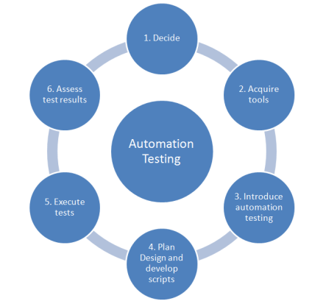
Yashwanth Reddy Bommineni
(Source:https://www.test-institute.org/Automated_Software_Testing.php)
Notes:
https://www.test-institute.org/Automated_Software_Testing.php

Slide 7
Challenges With Manual Testing
The applications must be tested manually by QA testers
Tests need to be performed manually in every environment
The success/ failure rate of every transaction should be recorded using different datasets
Users face fatigue, boredom, delay in work, mistakes and errors because of manual effort
This lead to the invention of automation testing tool
Yashwanth Reddy Bommineni
(Source:https://www.edureka.co/blog/what-is-selenium/)
Notes:
https://www.edureka.co/blog/what-is-selenium/

Slide 8
Yashwanth Reddy Bommineni
(Source:https://www.edureka.co/blog/what-is-selenium/)
Notes:
https://www.edureka.co/blog/what-is-selenium/

Slide 9

Features:
Flexible and Extensible
Multiple languages supported
HTML
Java
PHP
Perl
Python
Ruby
C#
Multiple Browsers supported
IE
Mozilla Firefox
Safari
Google Chrome
Opera
Yashwanth Reddy Bommineni
(Source:https://www.edureka.co/blog/what-is-selenium/)
Notes:
https://www.edureka.co/blog/what-is-selenium/

Slide 10
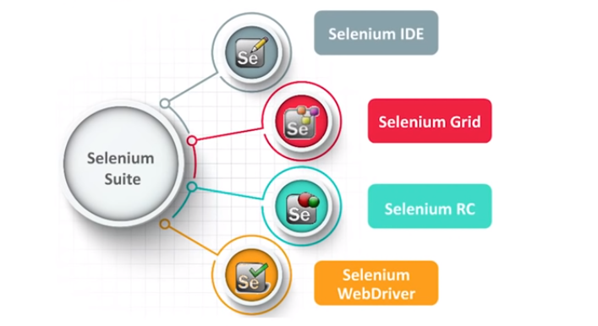
Components of Selenium
Selenium IDE
Selenium Grid
Selenium RC
Selenium WebDriver
SaiCharan Gurudu
(Source:https://www.edureka.co/blog/what-is-selenium/)

Slide 11
Selenium RC
By Paul Hammant
Overcame the problem with Selenium Core which is first tool of selenium
RC is a two-component tool :
Selenium RC Server
Selenium RC Client
RC Server communicates using simple HTTP GET/ POST requests.
SaiCharan Gurudu
(Source:https://www.edureka.co/blog/what-is-selenium/#SeleniumQTPRFT)
Notes:
Selenium Core was the first tool. But, Selenium Core hit a roadblock in terms of cross-domain testing because of the same origin policy. Same origin policy prohibits JavaScript code from accessing web elements which are hosted on a different domain compared to where the JavaScript was launched.
To overcome the same origin policy issue, testers needed to install local copies of both Selenium Core (a JavaScript program) and the web server containing the web application being tested so they would belong to the same domain.

Slide 12
Selenium IDE
Was founded by Shinya Kastani from Japan
was a Firefox plugin for faster creation of test cases
Advantage with Selenium IDE is that, tests recorded via the plugin can be exported in different programming languages like: Java, Ruby, Python etc
Plug-in only available for Mozilla Firefox; not for other browsers
It is not possible to test dynamic web applications; only simple tests can be recorded
Test cases cannot be scripted using programming logic
Does not support Data Driven testing
SaiCharan Gurudu
(Source:https://www.edureka.co/blog/what-is-selenium/#SeleniumQTPRFT)

Slide 13
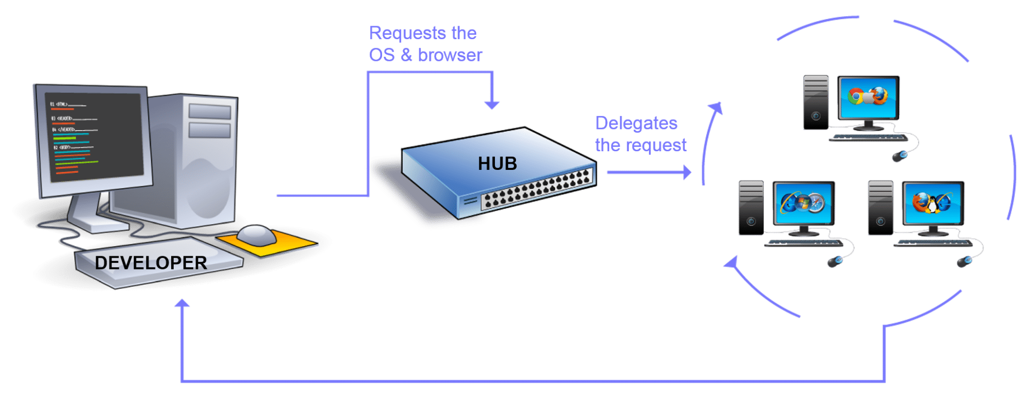
Selenium GRID
was developed by Patrick Lightbody
was used in combination with RC to run tests on remote machines
multiple test scripts can be executed at the same time on multiple machines
works with both WebDriver and RC
SaiCharan Gurudu
(Source:https://www.edureka.co/blog/what-is-selenium/#SeleniumQTPRFT)
Notes:
Parallel execution is achieved with the help of Hub-Node architecture. One machine will assume the role of Hub and the others will be the Nodes. Hub controls the test scripts running on various browsers inside various operating systems. Test scripts being executed on different Nodes can be written in different programming languages.

Slide 14
Selenium WebDriver
Founded by Simon Stewart in 2006
was the first cross platform testing framework that could control the browser from OS level
Selenium WebDriver provides a programming interface to create and execute test cases
WebDriver is an upgrade to RC because it is much faster
Each browser has its own driver on which the application runs
SaiCharan Gurudu
(Source:https://www.edureka.co/blog/what-is-selenium/#SeleniumQTPRFT)

Slide 15
Continuous Integration
It is a methodology that caters to the building and testing of development work to identify and address the pain points before they become serious issues.
In the past, the standard procedure was a single daily build
In the current working ambience and requirements, this is done frequently, with only a few hours between tests
Gives a consistent feedback on the project’s status, so problems are solved before they become complex
Each time a product code is developed, it goes through an automatic CI process
(Source:https://www.cabotsolutions.com/2016/12/continuous-integration-testing-using-selenium/)
Dattu Bhargav
Notes:
https://www.cabotsolutions.com/2016/12/continuous-integration-testing-using-selenium

Slide 16
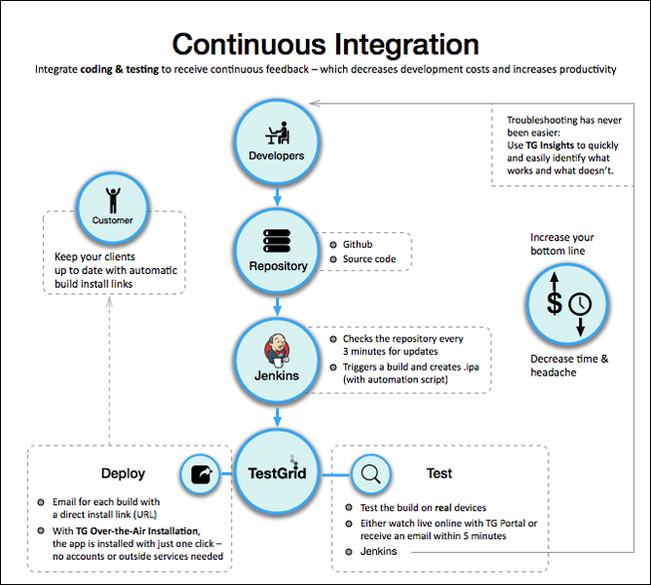
Dattu Bhargav
(Source:https://www.cabotsolutions.com/2016/12/continuous-integration-testing-using-selenium/)

Slide 17
Benefits of CI
Early Detection of Bugs
Helps in Determining Code-break
Only a small number of changes are lost when the code base reverts to a bug free state
Regular Availability of a “Current” Build
Enables Continuous Deployment
Enables Automated Testing
Reduces the Risk of a Longer, Time-Consuming Project
Increases the Quality of Your Software
Dattu Bhargav
(Source:https://www.cabotsolutions.com/2016/12/continuous-integration-testing-using-selenium/)

Slide 18
Commons Tools for CI Testing
CruiseControl
Bamboo
Jenkins
Buildbot
Travis CI
Strider
Go
Jenkins is the best tool for continuous integration
Dattu Bhargav
(Source:https://www.cabotsolutions.com/2016/12/continuous-integration-testing-using-selenium/)

Slide 19
DEMO
Vamshi Raj Jennaikode

Slide 20
References
https://www.edureka.co/blog/what-is-selenium/#SeleniumQTPRFT
https://www.test-institute.org/Automated_Software_Testing.php
https://www.edureka.co/blog/what-is-selenium/
https://www.cabotsolutions.com/2016/12/continuous-integration-testing-using-selenium/
https://www.youtube.com/watch?v=cNKi0Pl5wbc&t=54s

Slide 21
THANK YOU

